Slide 1
Work Progress
By: Abdur Rehman

Slide 2
Vanilla Network: Best Hyperparameters
Hyperparameters | values
input_delay_size | 4
activation_ | sigmoid
learning_rate | 0.001
units_nodes_ | 30
hidden_layers | 3
momentum_best | 0.5
batch_size_best | 64
regularizers | regularizers.L2(1e-3)

Slide 3
Evaluation
 | accuracy_train
loss | 6.78158612572588e-05
mean_squared_error | 6.780464173061773e-05
accuracy | 0.9100000262260437
root_mean_squared_error | 0.0082343565300107
 | accuracy_test
loss | 0.00013543205568566918
mean_squared_error | 0.00013542079250328243
accuracy | 0.8926174640655518
root_mean_squared_error | 0.01163704413920641

Slide 4
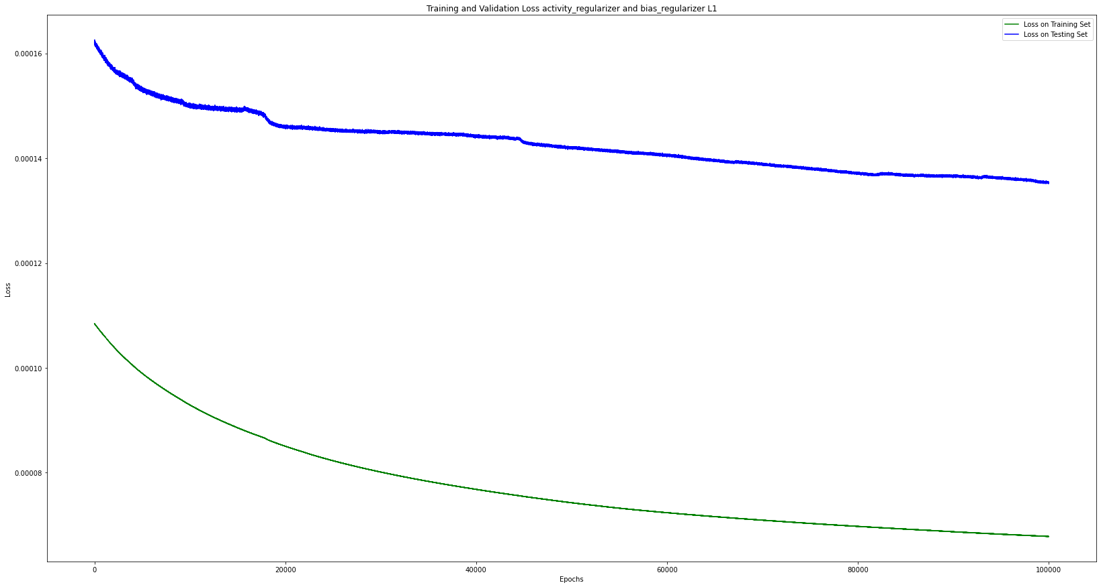

Slide 5
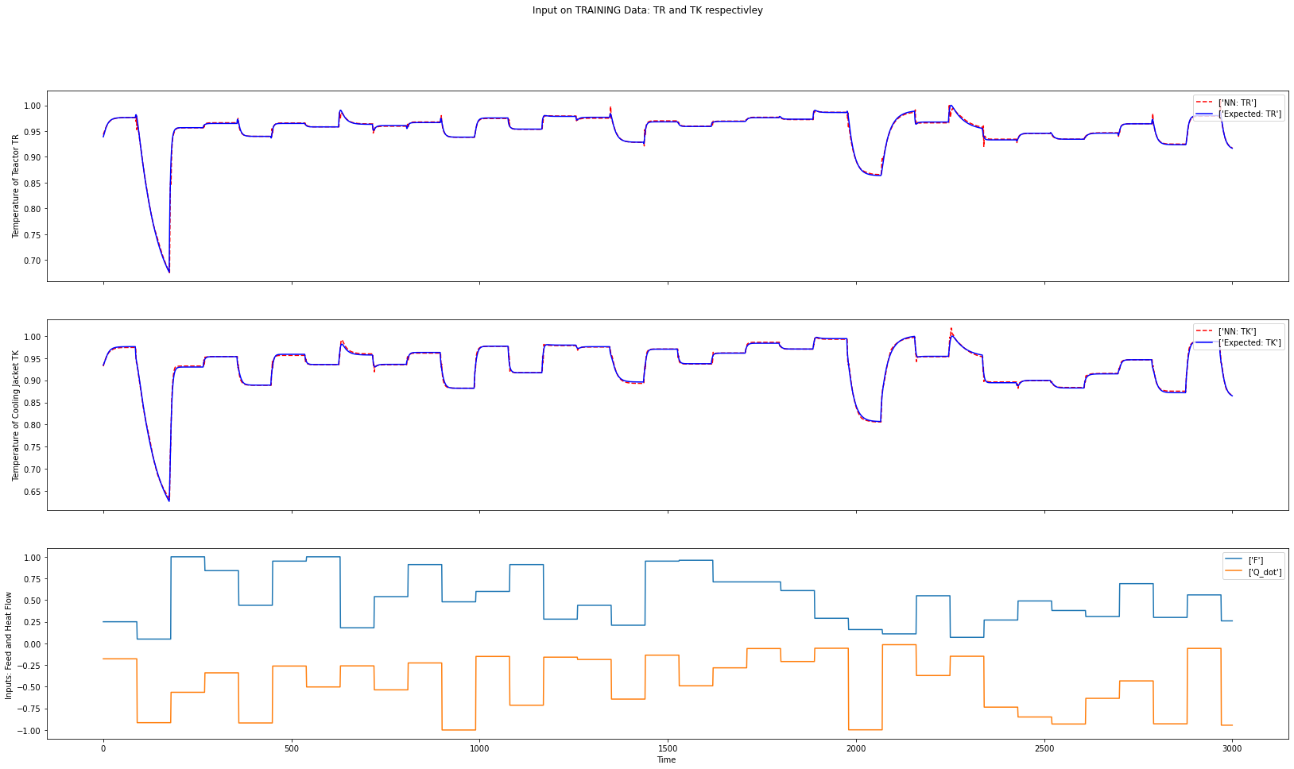

Slide 6
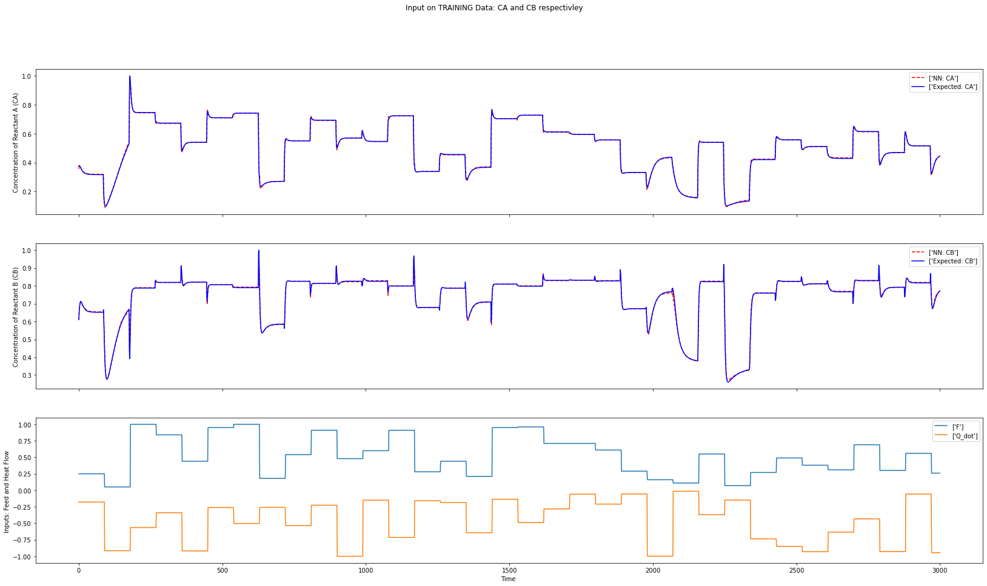

Slide 7
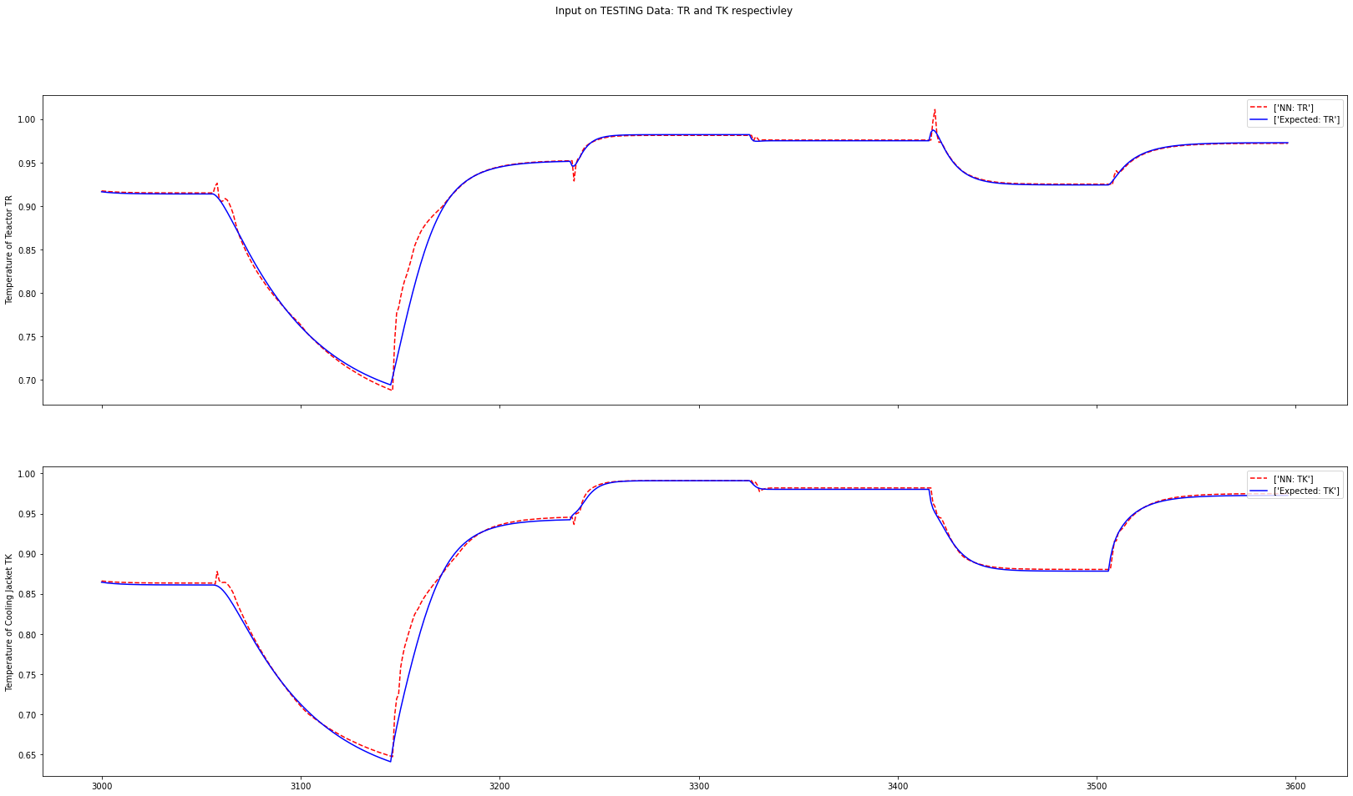

Slide 8
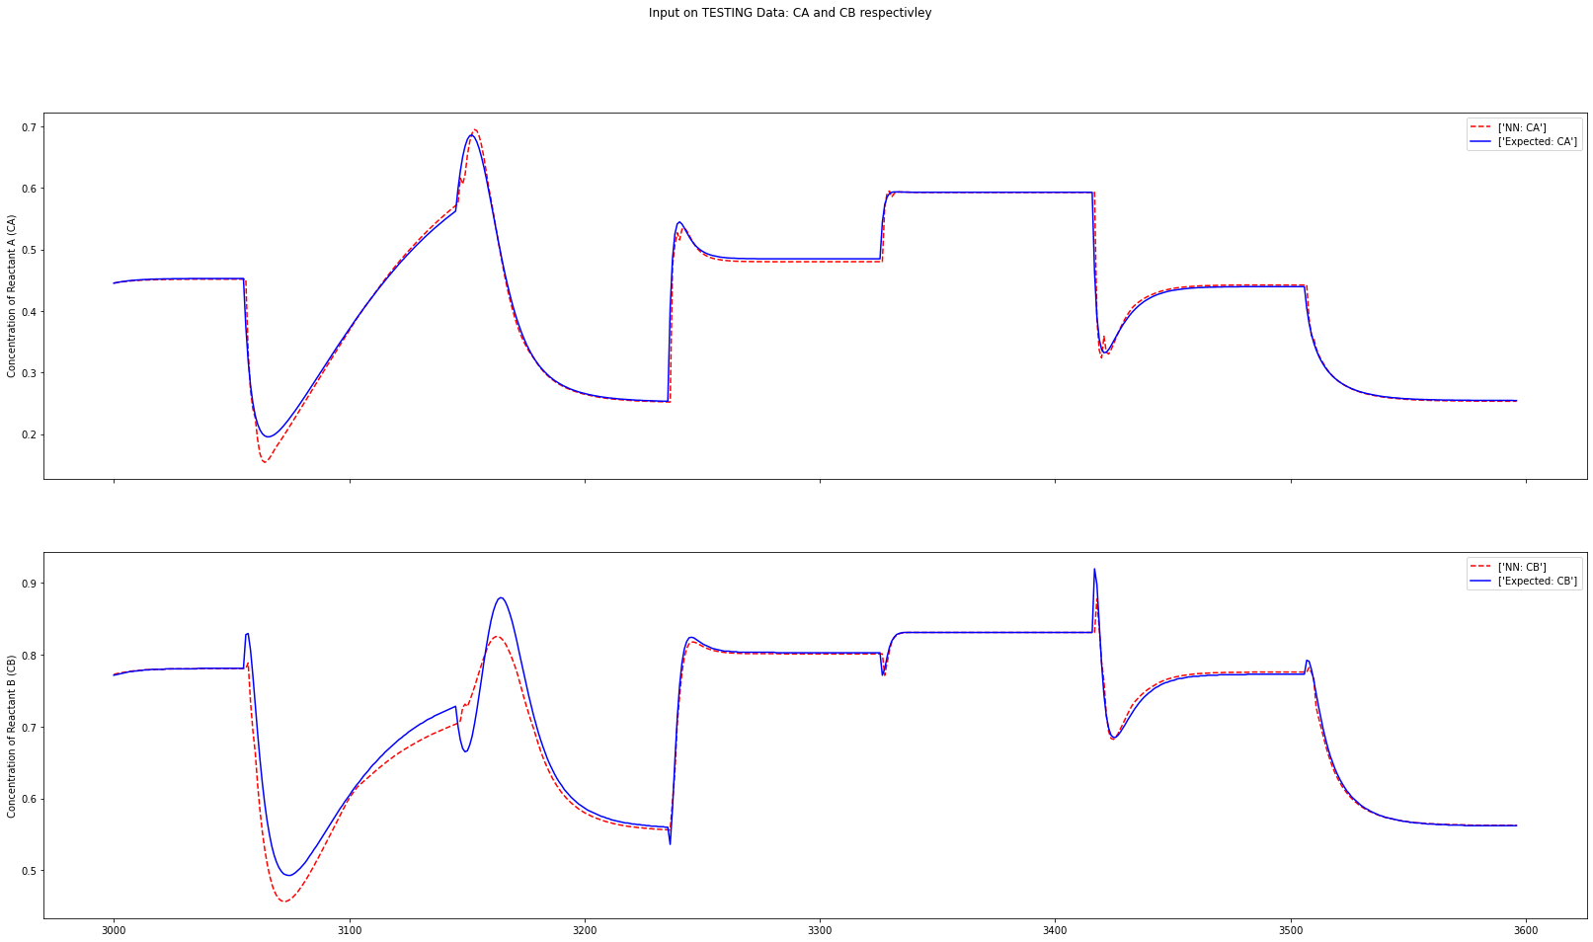

Slide 9
PGNN

Slide 10
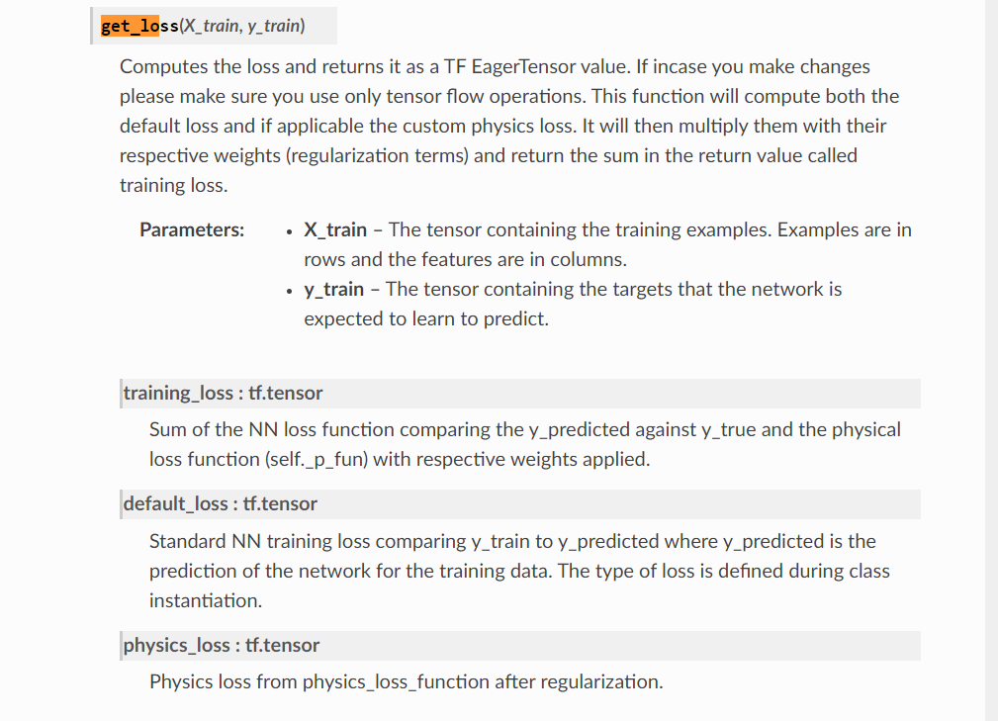
Loss on Training Set: (<tf.Tensor: shape=(), dtype=float32, numpy=5.0839133>, <tf.Tensor: shape=(), dtype=float32, numpy=1.1504257>, <tf.Tensor: shape=(), dtype=float32, numpy=3.9334877>)
default_loss
Physics_loss

